Slide 1

MEMORY GAME
USING JAVA SWINGS/ AWT

Slide 2


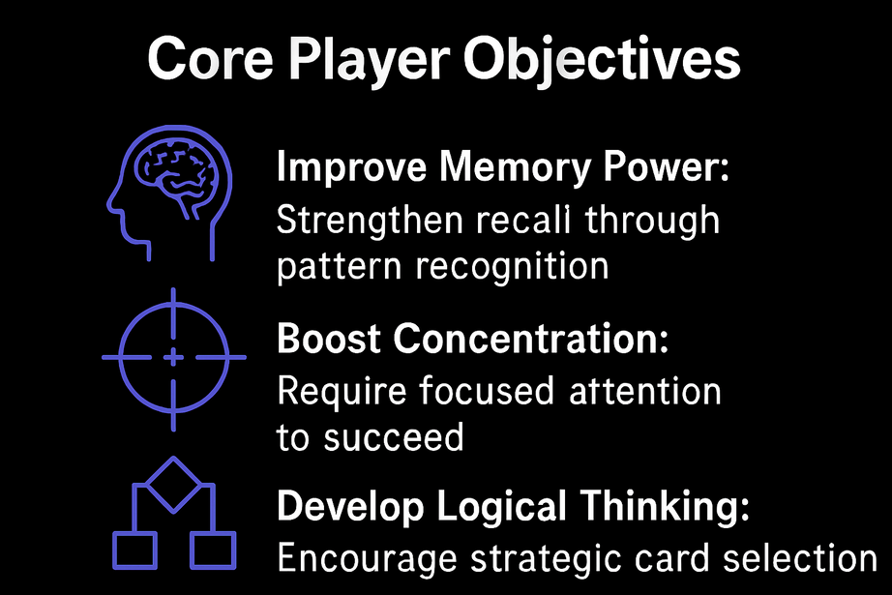
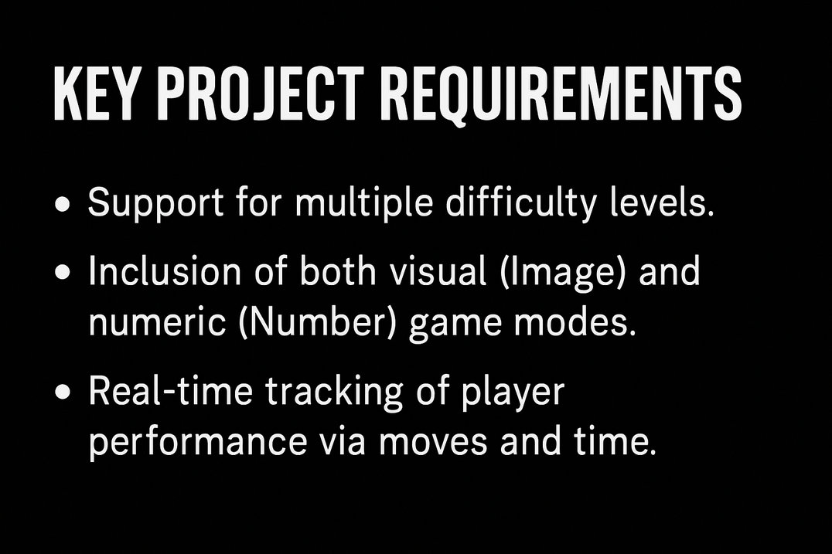
PROBLEM STATEMENT
Many traditional games lack interactive learning elements.
Need for a simple, fun, and logic-based game.
Core Player Objectives
Key Requirements

Slide 3
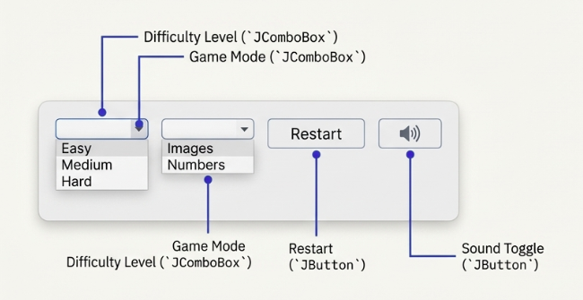
User interacts with the game using mouse clicks
Input components used:
Card clicks (JButton) to flip cards
Difficulty selection (JComboBox)
Easy (4×4), Medium (6×6), Hard (8×8)
Mode selection (JComboBox)
Image mode
Number mode
Sound toggle button to turn sound ON/OFF
Restart button to reset the game
Input handling is managed through ActionListener
Multiple inputs are controlled using flags to prevent invalid actions
INPUT

Slide 4
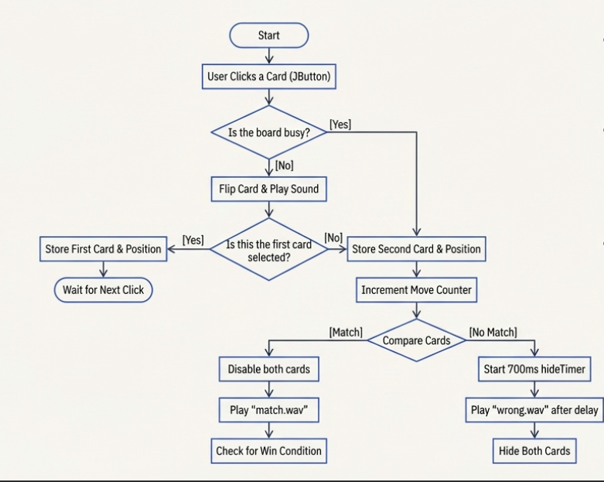
APPROACH
GAME BUILT USING JAVA SWING GUI
CARDS ARRANGED IN A GRID LAYOUT
EACH CARD HAS:
HIDDEN STATE
REVEALED STATE
LOGIC FLOW:
FLIP FIRST CARD
FLIP SECOND CARD
COMPARE BOTH CARDS
MATCH → KEEP OPEN
NO MATCH → HIDE AGAIN
TIMERS USED FOR:
HIDING CARDS
TRACKING GAME TIME

Slide 5
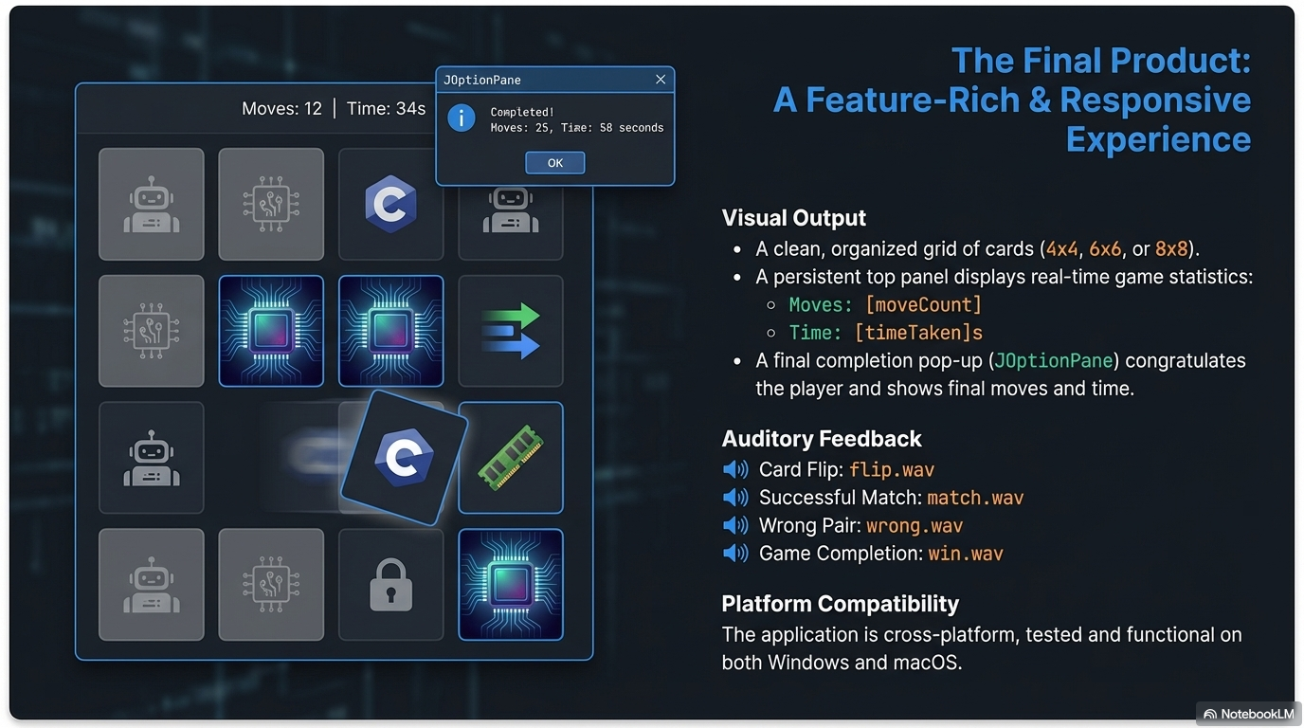

Slide 6
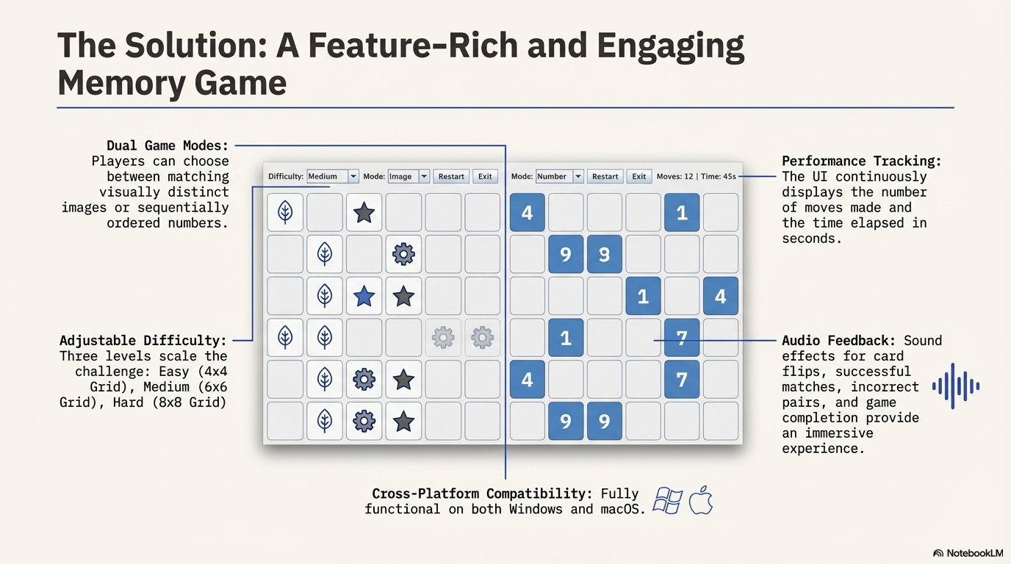

Slide 7
CONTRIBUTIONS
I Jaswanth
SE23UMCS015
Game Logic & Flow
Designed the core game logic (card flipping, matching pairs, move counting).
Implemented actionPerformed(), hideCards(), resetSelection().
Controlled game states (busy, started, firstCard, secondCard).
Implemented win condition check using checkFinished().

Slide 8
S Yashwanth Reddy
SE23UMCS058
GUI Design (Swing & AWT)
Designed the user interface layout using JFrame, JPanel, GridLayout, and BorderLayout.
Created and styled buttons, labels, combo boxes.
Implemented the top control panel (Moves, Time, Level, Mode, Theme, Restart).
Managed board creation in createBoard().

Slide 9
L Revanth
SE23UMCS051
Graphics & Card Generation
Implemented dynamic card generation for Images and Numbers modes.
Created custom card visuals using BufferedImage and Graphics2D.
Implemented createNumberIcon() and createBackIcon().
Managed image scaling and shuffling logic.

Slide 10
L Mohan Royal
SE23UARI142
Sound & Resource Management
Integrated sound effects using javax.sound.sampled.
Implemented playSound() for flip, match, wrong, and win sounds.
Handled resource loading for images and sounds.
Added sound toggle functionality (🔊 / 🔇).

Slide 11
Dheeraj Sai Sudheesh Vakada
SE23UARI163
Game Features & Enhancements
Implemented difficulty levels (Easy, Medium, Hard).
Implemented time tracking using javax.swing.Timer.
Added dark/light theme switching.
Implemented restart functionality and UI updates.

Slide 12
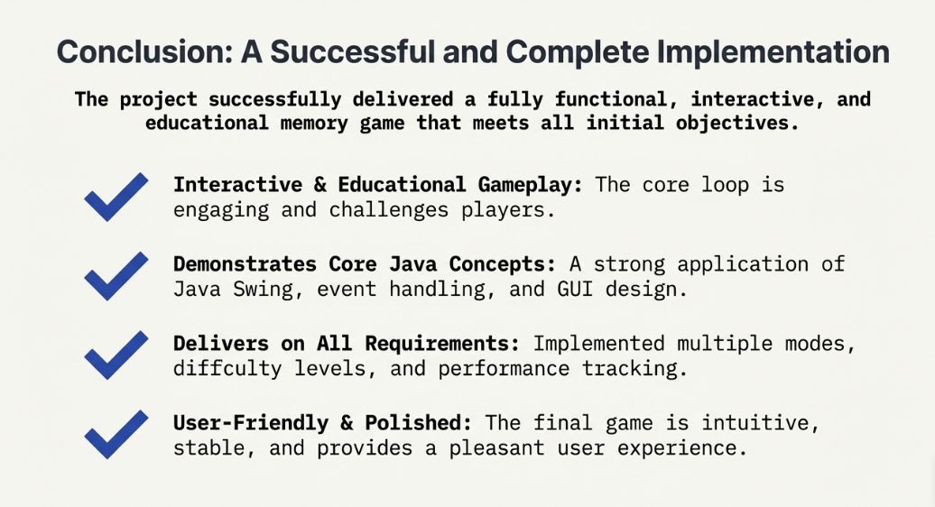

Slide 13
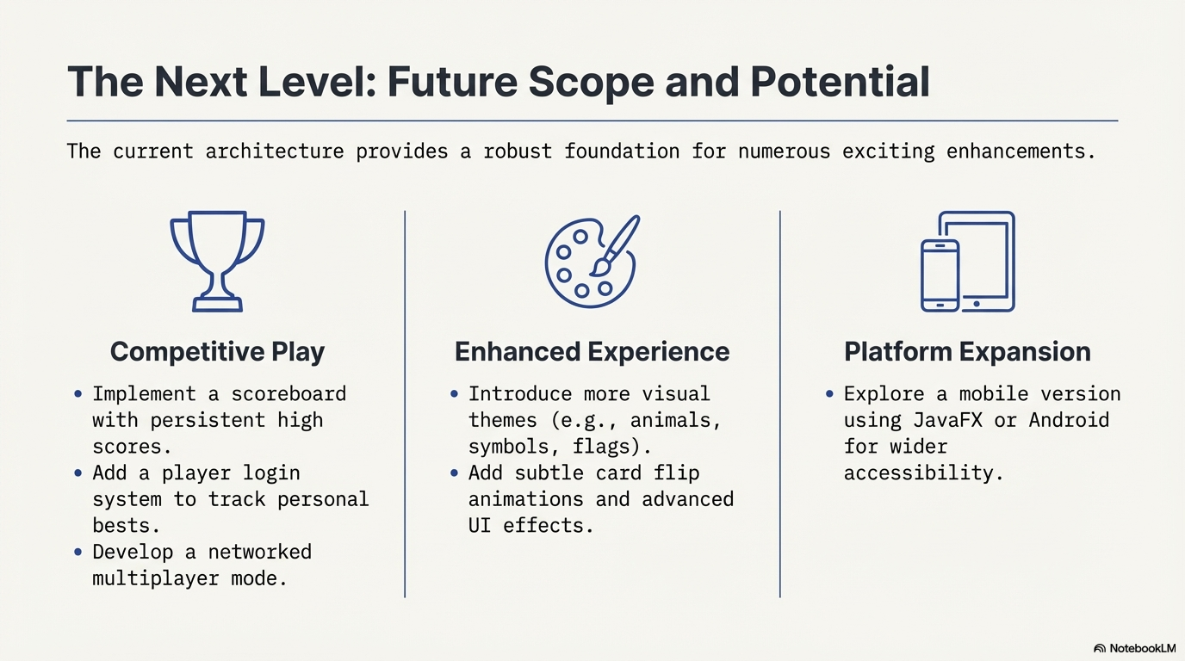

Slide 14
THANK YOU

